Slide 1
Explainable Machine Learning for Early Assessment of COVID-19 Risk Prediction in Emergency Departments
E. Casiraghi, D. Malchiodi, G. Trucco, M. Frasca, L. Cappelletti, T. Fontana, A. A. Esposito, E. Avola, A. Jachetti, J. Reese, A. Rizzi, P. N. Robinson, and G. Valentini

Slide 2
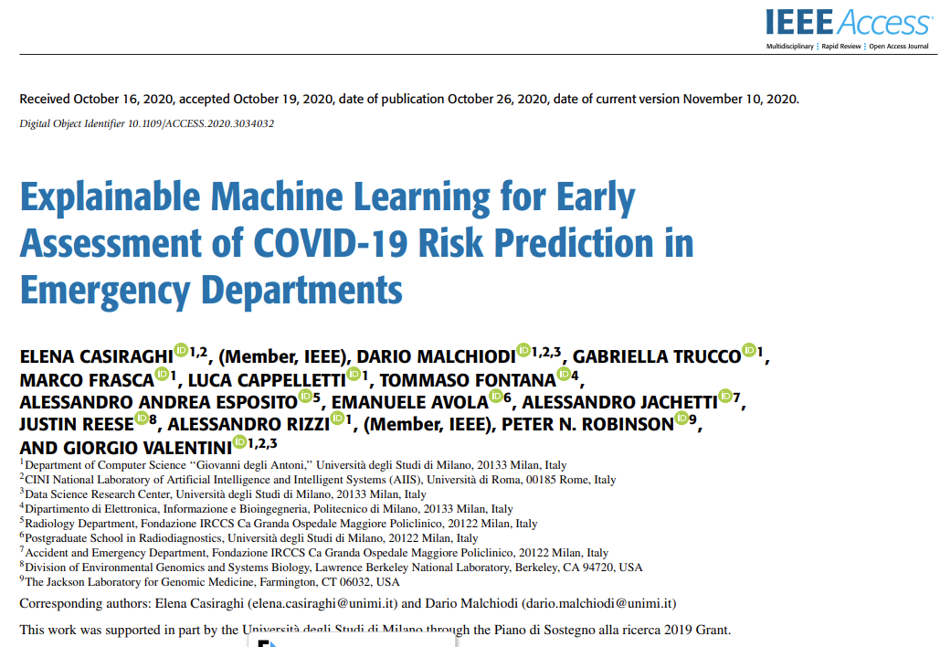
DOI 10.1109/ACCESS.2020.3034032

Slide 3
Objective
Proposing prediction models for early assessment of COVID-19 severity
Optimizing patients’ flow and waiting times in Emergency Departments (EDs)
Integrating clinical, laboratory and radiological data
Specifically designed for easy deployment in EDs (thanks to...)
Explainable output (feature relevance and prediction rules)

Slide 4
Strengths
Thorough missing data imputation studies
Robust feature selection process
Comparison between different prediction models:
Random Forests
Generalized Linear Models
Associative Trees
MLPs
Logistic Regression
Support Vector Machines

Slide 5
Strengths
Thorough missing data imputation studies
Robust feature selection process
Comparison between different prediction models:
Random Forests
Generalized Linear Models
Associative Trees
MLPs
Logistic Regression
Support Vector Machines
Results not shown due to much lower performance

Slide 6
Biases to avoid
Lack of clinical follow-up data (with the risk of inaccurate labels)
Suboptimal predictor measurements (e.g., the last available ones rather than those acquired in EDs)
Population not clearly described
Models described only in part / not suitably tested
Hyperparameters setting is not robust / not reported
(see L. Wynants et al., ‘‘Prediction models for diagnosis and prognosis of COVID-19: Systematic review and critical appraisal,’’ BMJ, vol. 369, no. 369, 2020)

Slide 7
In a nutshell
Dataset acquisition
Missing data imputation
Feature selection
Model explanation
Model induction

Slide 8
In a nutshell
(External) 10-fold cross Validation
Dataset acquisition
Missing data imputation
Feature selection
Model induction
Model explanation

Slide 9
Data Collection and Filtering
ED admissions in urban multicenter health system
March, 7th – April 10th 2020
COVID-19 positive (RT-PCR)
Five-months clinical follow-up:
Low risk (no hospitalization, no serious consequences): 214 patients
High risk (intubation, serious consequences, death): 87 patients
Variables were excluded if > 50% values were missing or they had negligible variance

Slide 10
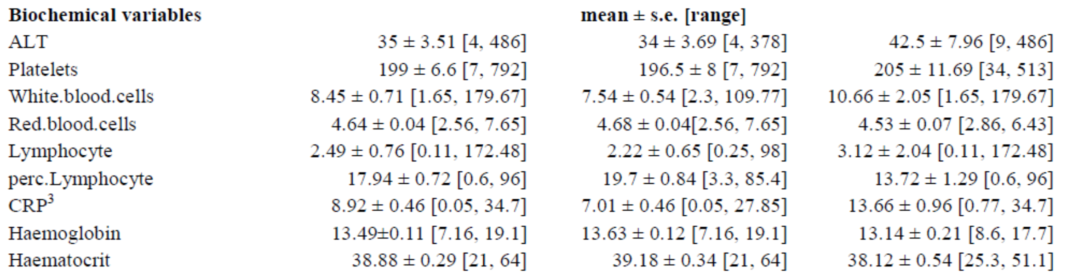
THE Dataset
207+94 adult men and women
Age: 61±1 years [23–95]
Days with symptoms: 7±0 [1–30]
Symptoms [fever, cough, etc.]
Clinical history, comorbidities [cancer, asthma, etc.]
Laboratory measurement [LDH, AST, white blood cell count, red blood cell count, Lymphocytes, CRP, Haemoglobin, Haematocrit]
Saturation/oxygen value
CRX
Age, gender

Slide 11
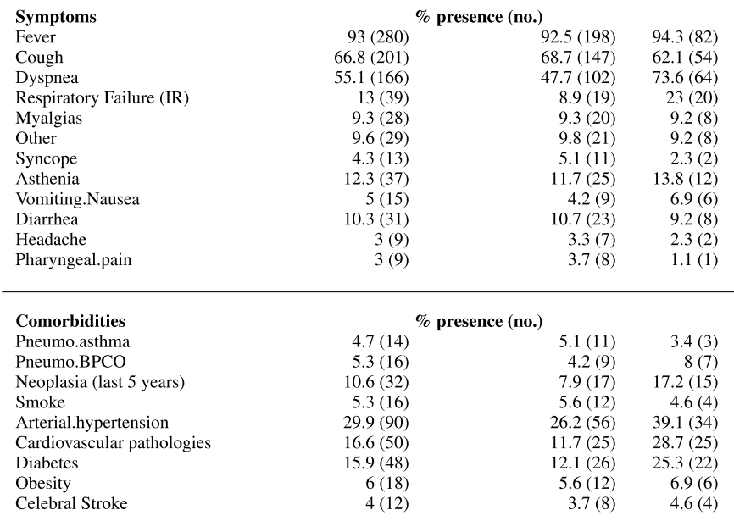

Slide 12
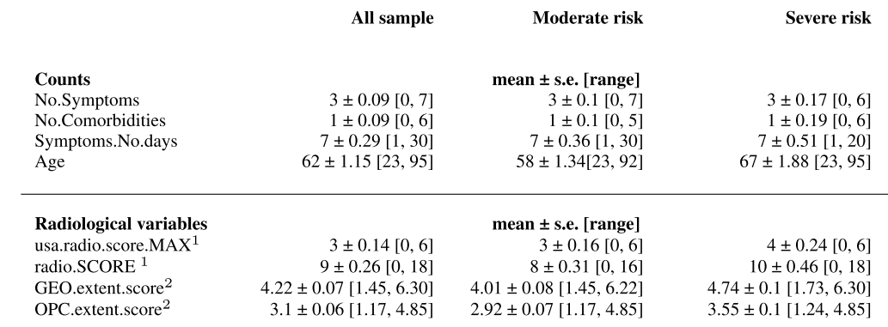
CXR used as a first-line triage tool
Less sensitive in early stage
Less burden
Indices 1: experienced radiologists
Indices 2: Covid-Net DNN

Slide 13
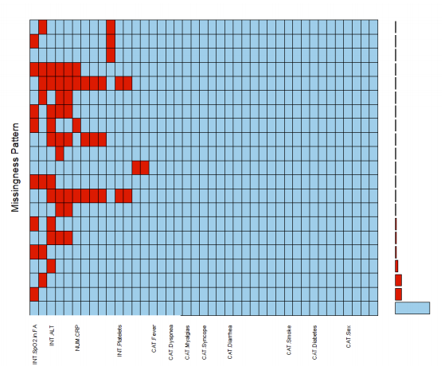
Missing data patterns
No high correlation among patterns
Independence of missing/observed proportions
No significant difference between distributions of other attributes corresponding to observed and missing values
Thus, no MNAR

Slide 14
MAR or MCAR?
Jamshidian and Jalal test (homoscedasticity test for data having identical missingness patterns is a proxy for MCAR)
Homoscedasticity tested using Hawkins test for complete datasets
Completeness obtained after distFree imputation (only assuming independence)
Result: MCAR

Slide 15
Missing data imputation
Multiple Imputation by Chained Equations
Each variable cyclically predicted from remaining ones (+randomness source)
Several “donor” predictions relying on Predictive Mean Matching (micePMM) or Random Forests (miceRF), imputation selected among donors
Prediction cycles repeated several times
missForest
Repeatedly train RFs to predict one variable from remaining ones (only one hyperparameter, no distributional assumptions)
distFree
Imputation via ML linear predictors + random errors

Slide 16
Boruta Feature selection
Add “fake” features (random permutation of each original feature)
Train RF, retain/discard original features which resulted as important* for a statistically significant number of times, set remaining features as tentative

Slide 17
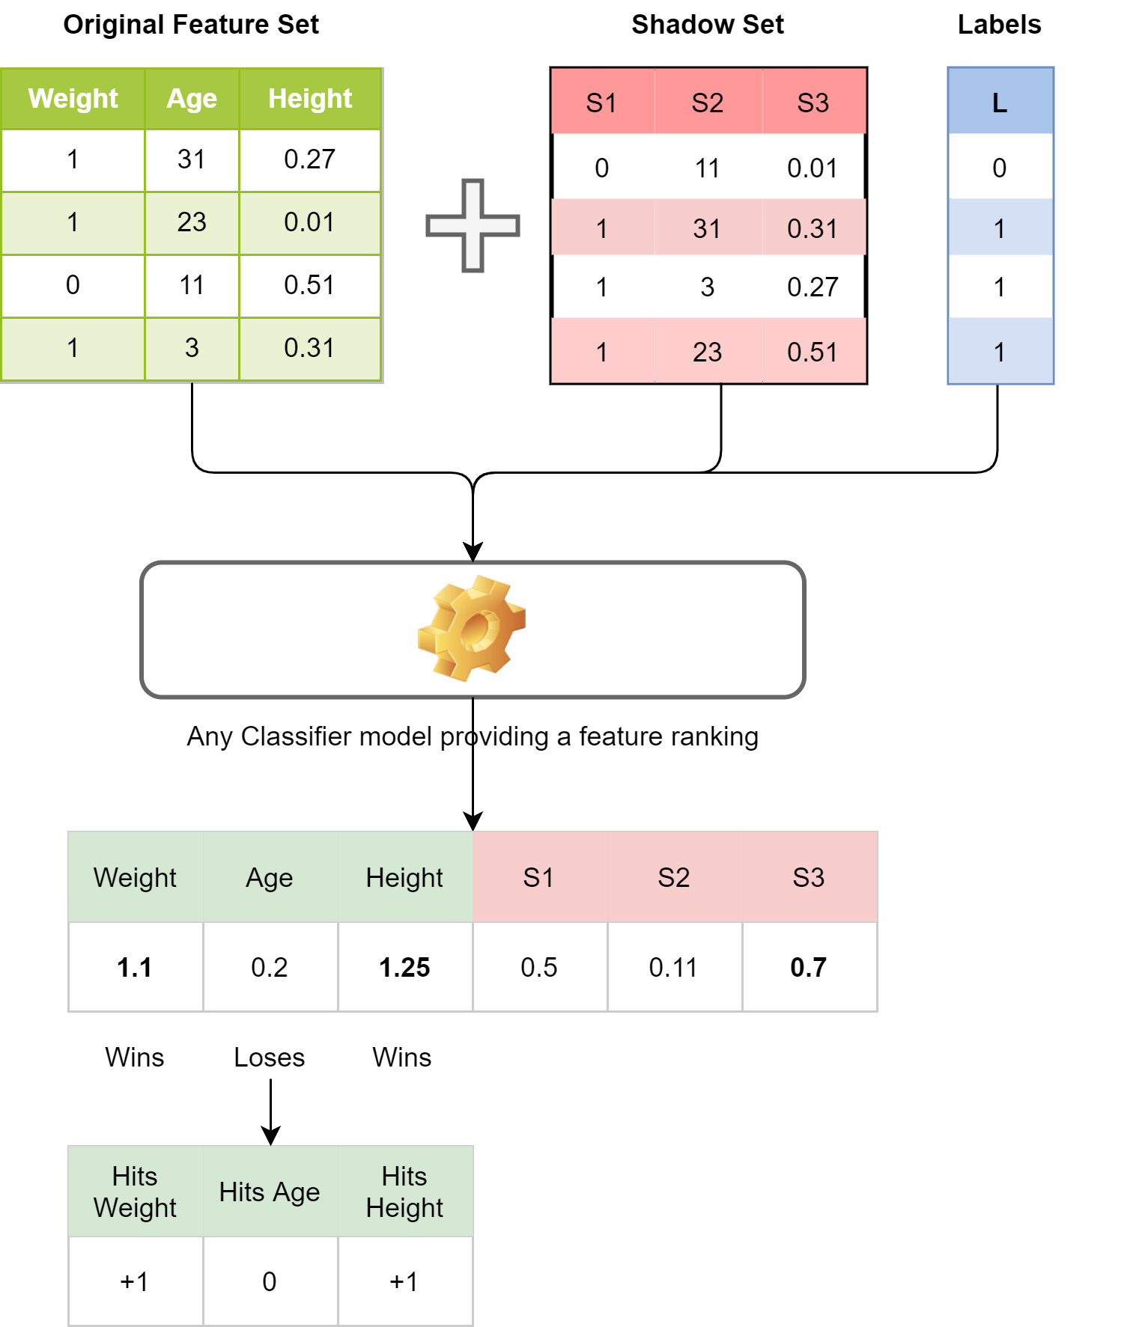
Boruta Feature selection

Slide 18
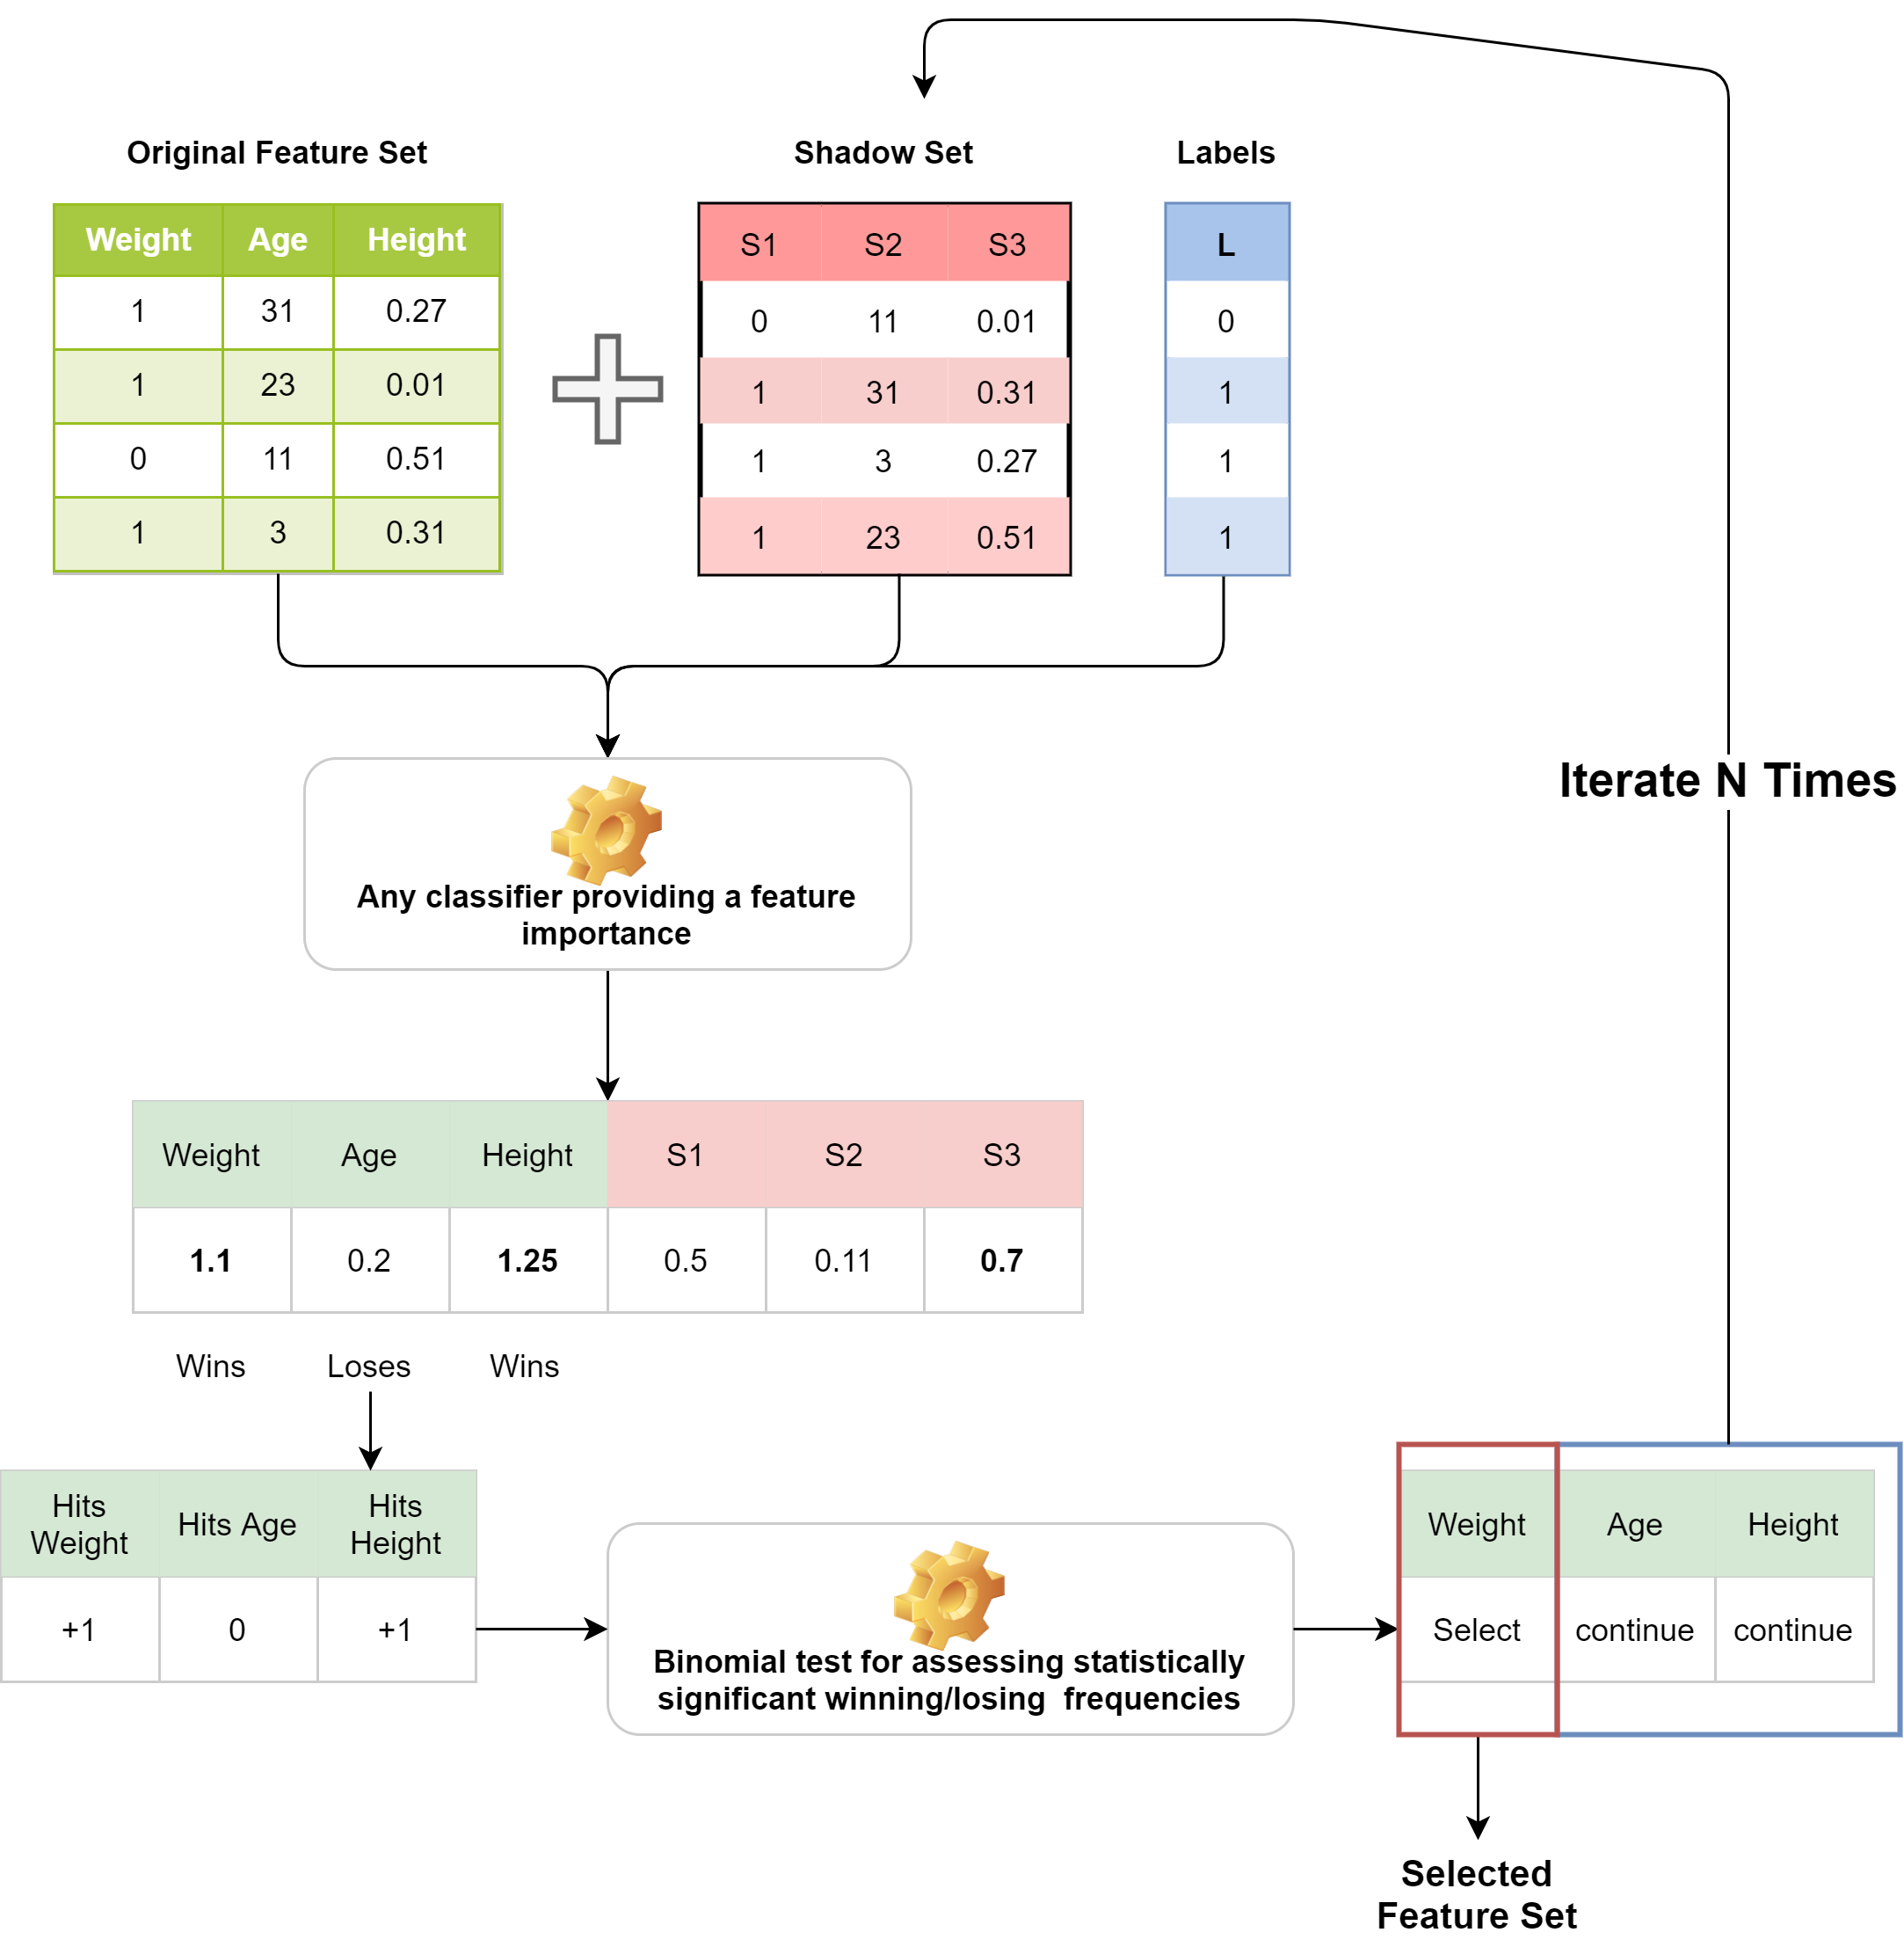
Boruta Feature selection

Slide 19
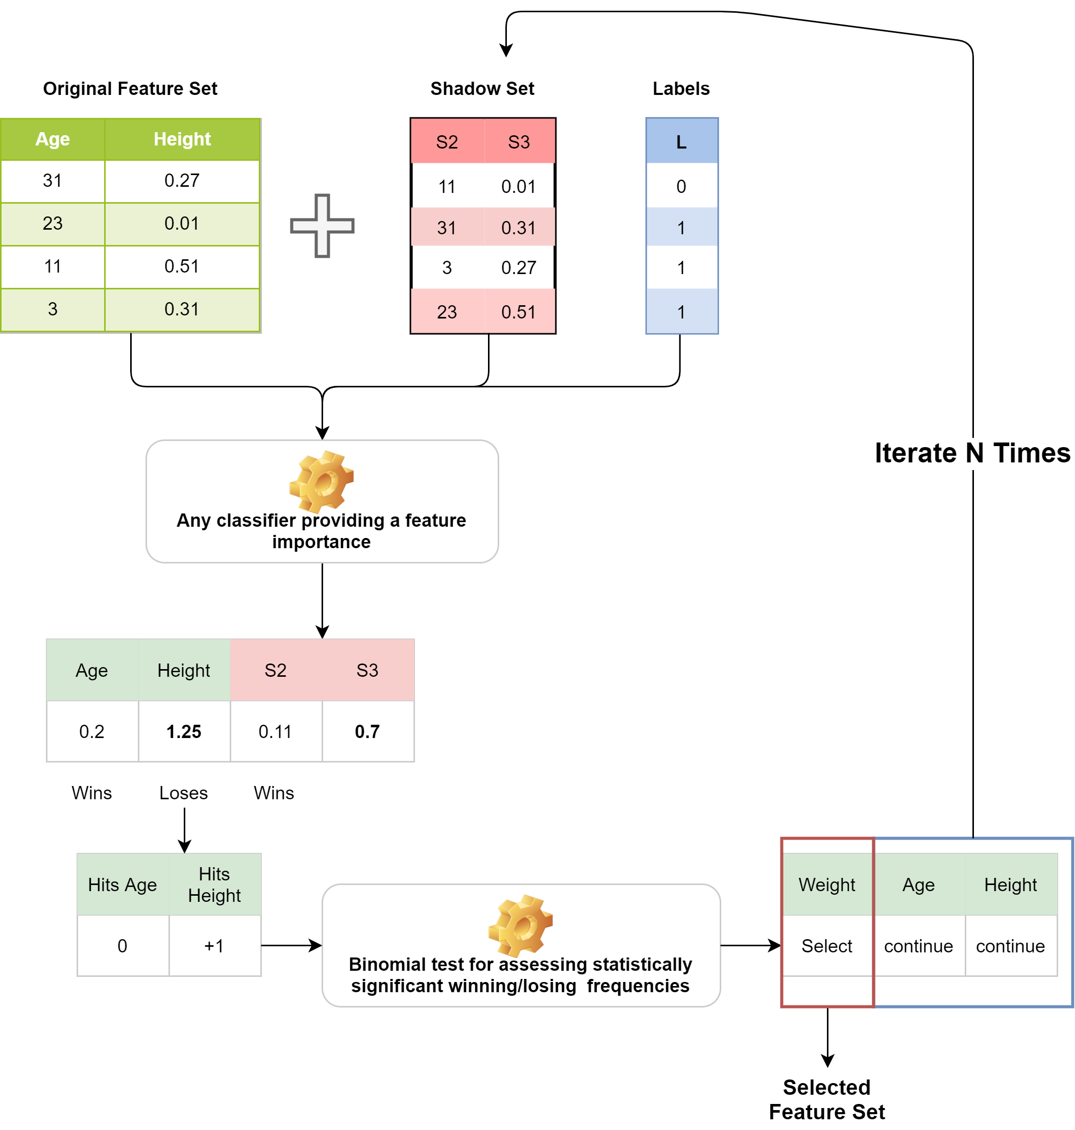

Slide 20
How to solve the “tentative” drama?
Use internal k_{RF_ext}-fold cross-validation
For each fold j in 1 … k_{RFext}
Run k_{B_int} times* Borutaand keep features judged as selected or tentative for > k_{B-int}/2 times
Train a rebalanced* RF on selected features and measure feature importance
keep “most important” features are kept

Slide 21
Risk prediction: Random Forest
Hyper-parameters: n. of trees (fixed after preliminary grid search), n. of variables per split (greedy search), min. size of leaves (fixed following clinical experts advice)
Class imbalance dealt via tailored bootstrap sampling
Model assessment in a 10-fold CV
Importance of predictors normalized in each fold, followed by averaging

Slide 22
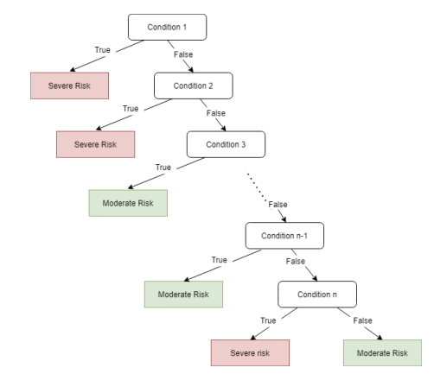
Model explainability
RF are explainable, but tend to produce a big number of complex rules
Solution: translate trees in the forest into Associative Trees

Slide 23
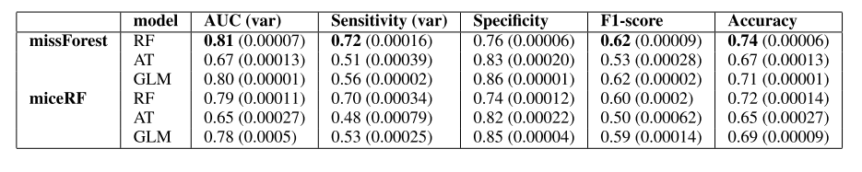
Results
AUC drove selection of imputation + learning algorithm
Other metrics drove selection among learnt models
Mean & Variance within 10-CV computed via Rubin’s rule
Statistical analyses confirm missForest+RF as best performing combination

Slide 24
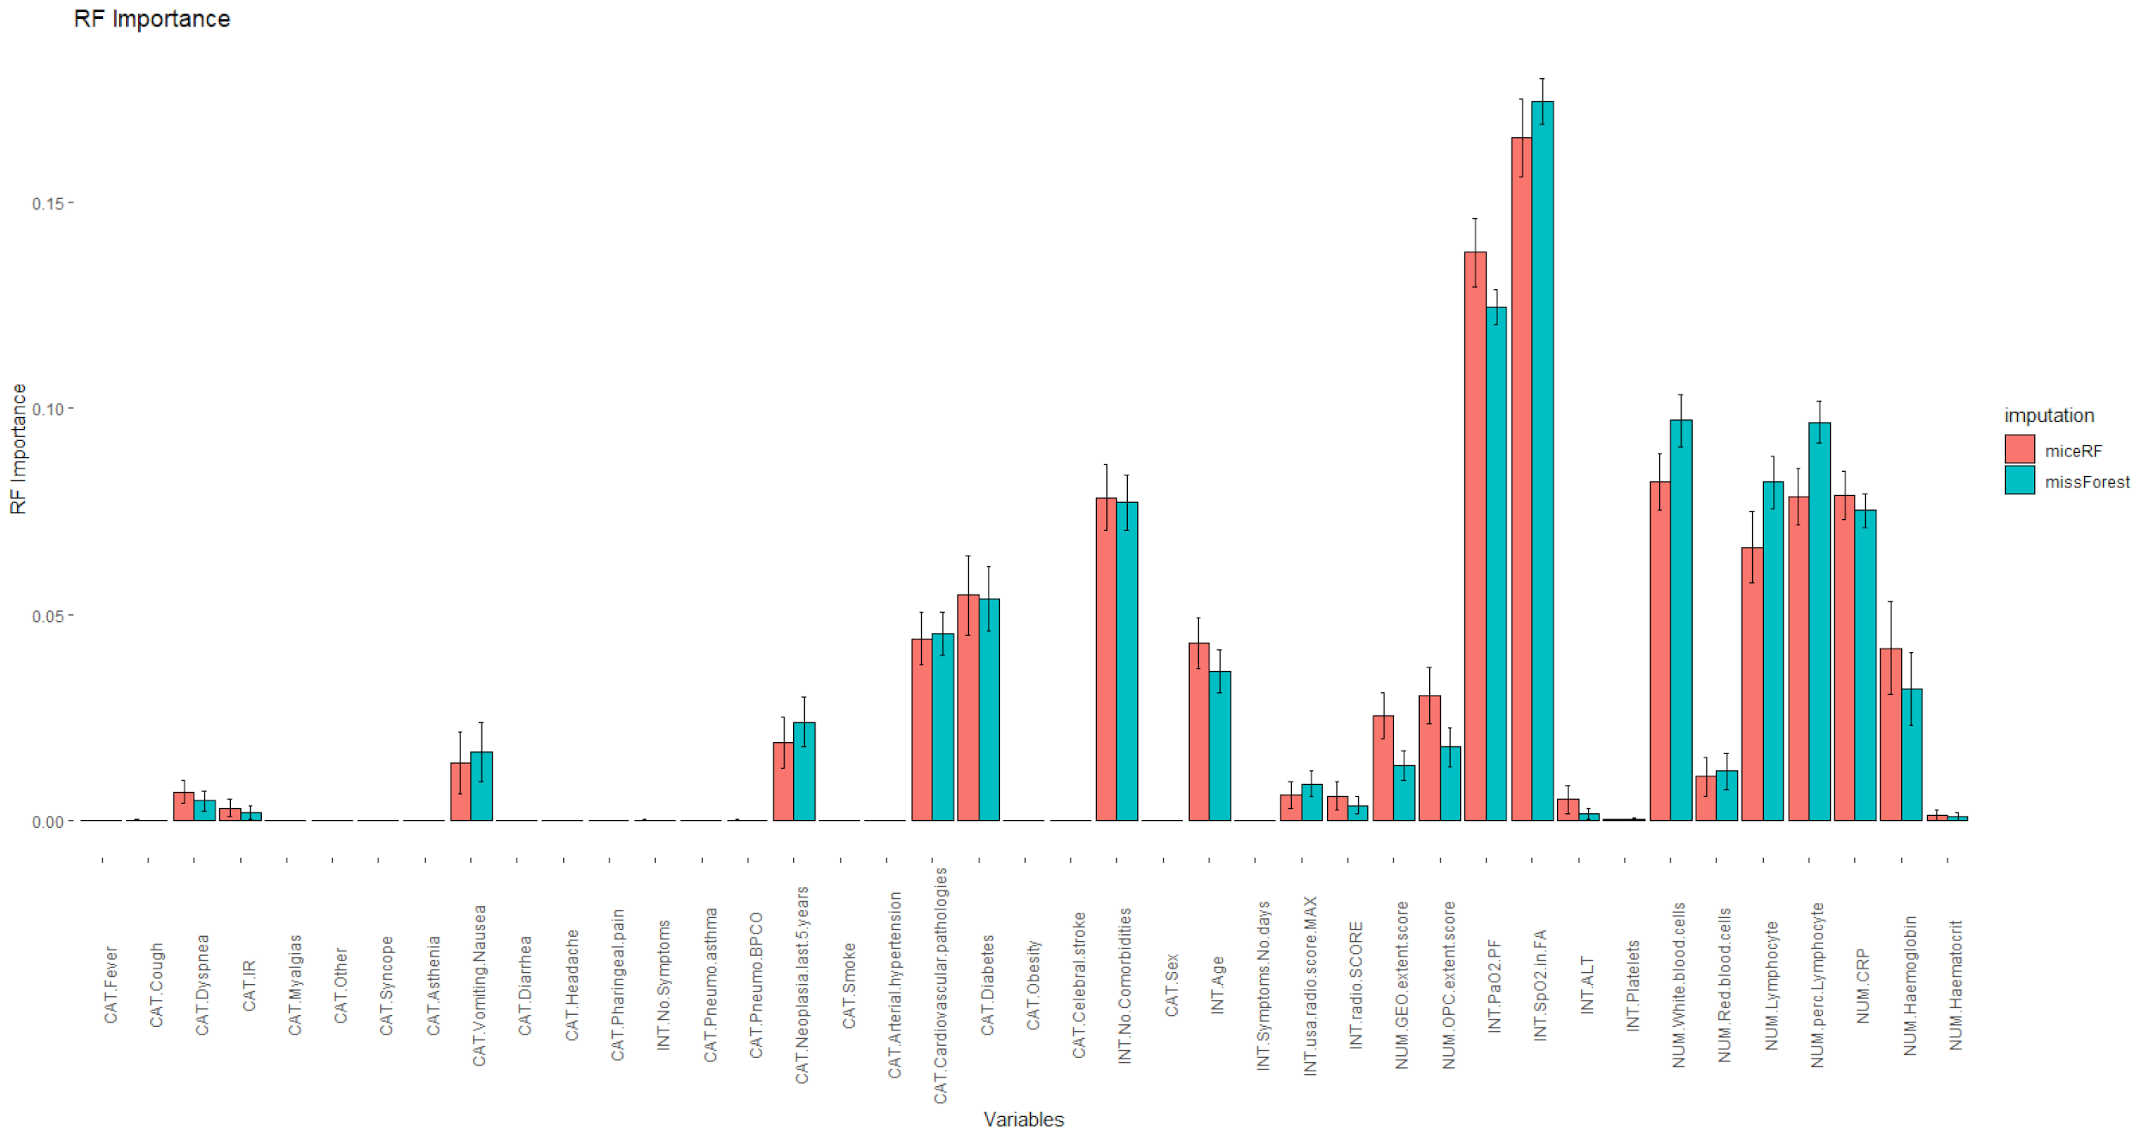
Feature Relevance
PaO2.PF
SpO2.in.FA
White.blood.cells
Lymphocyte
%Lymphocyte
C-Reactive Protein
Diabetes
No.Comorbidities

Slide 25
Implementation
R code publicly available at https://github.com/AnacletoLAB/DataAnalysisR/tree/main/Rcode_clinicalDataNew
A bit tailored on the experiments (use AYOR)
Documentation not available
Might however be a good starting point for a modular implementation on N3C Enclave

Slide 26
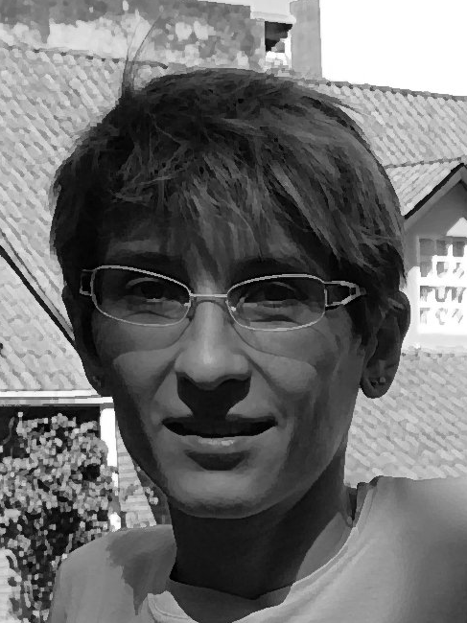


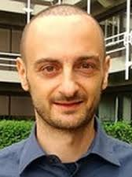




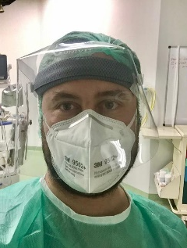


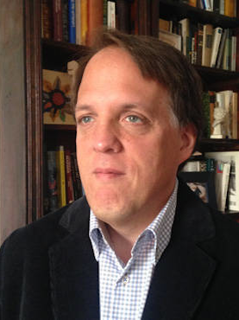

Thanks!
Questions

Slide 27
What’s next?

Slide 28
- Imputation as an “internal” processing step - Graph based feature imputation - try network-medicine approaches Test the model on: - Cremona Dataset (private by now but it may - sooner or later - be in N3C? ) - HUST-19 dataset http://ictcf.biocuckoo.cn/HUST-19.php

